Slide 1
CRYPTOWATCH

Slide 2
Group No. 79
1. Abhijeet Chatterjee 19BCE10021
2. Raj Aryan 19BCE10421
3. Aniket Mishra 19BCE10385
4. Soumyadip Majumder 19BCE10206

Slide 3
TABLE OF CONTENTS
01
02
About Crypto
About our Project
1. What is Crypto?
2. Types of CryptoCurrency tokens
3. What is Crypto-Trading?
4. How does CryptoMarket works.
5. Benefits of Cryptocurrency
1. Problem Statement
2. Types of Cryptocurrency Scams
3. Aim of Our Project

Slide 4
01
ABOUT CRYPTO

Slide 5
WHAT IS CRYPTO ??
A cryptocurrency or crypto is a digital or virtual currency that is secured by cryptography, which makes it nearly impossible to counterfeit or double-spend. Many cryptocurrencies are decentralized networks based on blockchain technology (a distributed ledger enforced by a disparate network of computers).
A defining feature of cryptocurrencies is that they are generally not issued by any central authority, rendering them theoretically immune to government interference or manipulation.

Slide 6
TYPES OF CRYPTOCURRENCY TOKENS
A categorization system has materialized to explain the different types of cryptocurrency and help people navigate the landscape. A complete understanding of crypto begins with a review of the most prevalent token types:
Utility Tokens
  Utility tokens are thought of as coupons or vouchers but essentially are digital units representing a value on the blockchain.
  Examples : Funfair, Brickblock, Timicoin, Sirin Labs Token, and Golem.
Security tokens
  These are securitized cryptocurrencies that derive value from an external asset that can be traded under a financial regulation as security. They, therefore, are used for securitized tokenization of properties, bonds, stocks, real-estates, property, and other real-world currencies.
  Examples : Sia Funds, Bcap (Blockchain Capital), and Science Blockchain.

Slide 7
TYPES OF CRYPTOCURRENCY TOKENS
Transactional tokens
  Those used for buying and selling goods and services on digital platforms without an intermediary, as happens in traditional finance and banking arenas.
  Examples : Monero, Ethereum, and Bitcoin.
Exchange tokens
  There may be debate about what exchange tokens are but are given the name for their issuance by and use in the cryptocurrency exchanges, which are crypto marketplaces for buying and selling and swapping tokens.
  Examples : Binance Coin or BNB token, Gemini USD, FTX Coin for FTX Exchange, OKB for Okex exchange, KuCoin Token, Uni token, HT for Huobi exchange, Shushi, and CRO for Crypto.com.

Slide 8
WHAT IS CRYPTO-TRADING ?
Cryptocurrency trading is the act of speculating on cryptocurrency price movements via a CFD trading account, or buying and selling the underlying coins via an exchange.
CFD trading on cryptocurrencies
CFDs trading are derivatives, which enable us to speculate on cryptocurrency price movements without taking ownership of the underlying coins. We can go long (‘buy’) if we think a cryptocurrency will rise in value, or short (‘sell’) if we think it will fall.
Buying and selling cryptocurrencies via an exchange
When we buy cryptocurrencies via an exchange, we purchase the coins themselves. We’ll need to create an exchange account, put up the full value of the asset to open a position, and store the cryptocurrency tokens in our own wallet until we’re ready to sell.

Slide 9
HOW DO CRYPTOCURRENCY MARKET WORKS ?
Cryptocurrency markets are decentralized, which means they are not issued or backed by a central authority such as a government. Instead, they run across a network of computers.
Unlike traditional currencies, cryptocurrencies exist only as a shared digital record of ownership, stored on a blockchain. When a user wants to send cryptocurrency units to another user, they send it to that user’s digital wallet. The transaction isn’t considered final until it has been verified and added to the blockchain through a process called mining. This is also how new cryptocurrency tokens are usually created.
What is blockchain?
A blockchain is a shared digital register of recorded data. For cryptocurrencies, this is the transaction history for every unit of the cryptocurrency, which shows how ownership has changed over time. Blockchain works by recording transactions in ‘blocks’, with new blocks added at the front of the chain.
Blockchain technology has unique security features that normal computer files do not have.

Slide 10
Cryptography
Blocks are linked together by cryptography – complex mathematics and computer science. Any attempt to alter data disrupts the cryptographic links between blocks, and can quickly be identified as fraudulent by computers in the network.
What is cryptocurrency mining?
Cryptocurrency mining is the process by which recent cryptocurrency transactions are checked and new blocks are added to the blockchain.
Checking transactions
Mining computers select pending transactions from a pool and check to ensure that the sender has sufficient funds to complete the transaction. This involves checking the transaction details against the transaction history stored in the blockchain. A second check confirms that the sender authorized the transfer of funds using their private key.
Creating a new block
Mining computers compile valid transactions into a new block and attempt to generate the cryptographic link to the previous block by finding a solution to a complex algorithm. When a computer succeeds in generating the link, it adds the block to its version of the blockchain file and broadcasts the update across the network.

Slide 11
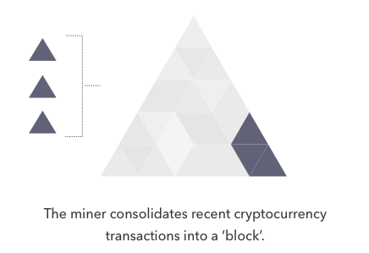
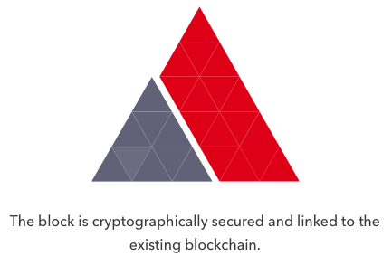
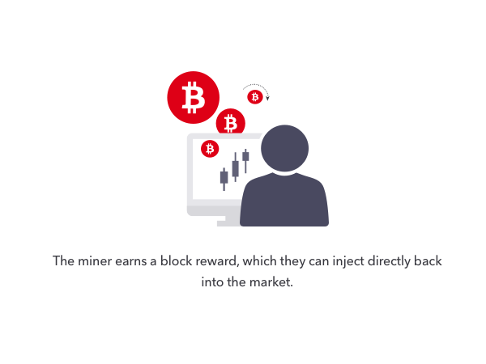
Creating a new block
Mining computers compile valid transactions into a new block and attempt to generate the cryptographic link to the previous block by finding a solution to a complex algorithm. When a computer succeeds in generating the link, it adds the block to its version of the blockchain file and broadcasts the update across the network.

Slide 12

BENEFITS OF CRYPTOCURRENCY
1. Transaction speed
Cryptocurrency transactions can be completed in a matter of minutes. Once the block with your transaction in it is confirmed by the network, it's fully settled and the funds are available to use.
2. Transaction costs
The cost of transacting in cryptocurrency is relatively low compared to other financial services. Cryptocurrency transactions are usually less expensive. However, one should note that demand on the blockchain can increase transaction costs.
3. Accessibility
Anyone can use cryptocurrency. All you need is a computer or smartphone and an internet connection. The process of setting up a cryptocurrency wallet is extremely fast compared to opening an account at a traditional financial institution. There's no ID verification. There's no background or credit check.

Slide 13
BENEFITS OF CRYPTOCURRENCY
4. Security
Unless someone gains access to the private key for your crypto wallet, they cannot sign transactions or access our funds. However, if we lose our private key, there's also no way to recover our funds. Furthermore, transactions are secured by the nature of the blockchain system and the distributed network of computers verifying transactions. As more computing power is added to the network, it becomes even more secure.
5. Privacy
Since we don't have to register for an account at a financial institution to transact with cryptocurrency, we can maintain a level of privacy. Transactions are pseudonymous, which means we have an identifier on the blockchain -- our wallet address -- but it doesn't include any specific information about us. This level of privacy can be desirable in many cases (both innocent and illicit).
6. Transparency
All cryptocurrency transactions take place on the publicly distributed blockchain ledger. There are tools that allow anyone to look up transaction data, including where, when, and how much of a cryptocurrency someone sent from a wallet address. Anyone can also see how much crypto is stored in a wallet.
7. Diversification
Cryptocurrency can offer investors diversification from traditional financial assets such as stocks and bonds.

Slide 14
02
ABOUT THE PROJECT

Slide 15
PROBLEM STATEMENT
New tokens are coming out every single day, many of them are honeypots which take investors' money and then dissolve. Leaving the investors in heavy losses.
But we can reduce a little risk but considering the pieces of information related to Token and how it is being perceived by investors across the world the price trend etc. And after considering some of the factors we can make our investment decision.
The new tokens which release at very low prices don't have records about them mentioned on the Crypto Websites because of their lack of popularity at the moment. But the data is available on Ethereum or Binance networks where the tokens are released. But to get that information we must have good knowledge of GraphQL and Crypto ParaDigms, which is not for all.

Slide 16
TYPES OF CRYPTOCURRENCY SCAMS
1. HoneyPots
A Honeypot is a type of Scam which allows people to buy tokens but prevents them from selling the token.
This essentially locks the Base tokens into the contract where only the Contract Owner can sell tokens and drain Liquidity (Rug Pull).
2. Unpopular Token Parity
If we pair Token with BNB.
we can use BNB to buy Token and sell Token for BNB based on the available liquidity and rate of pairing in the LP. So, if any other token used, dependency increases.
3. Unlocked Liquidity
If they do not lock Liquidity; they can technically withdraw all the Liquidity raised without having to interact with the smart contract and as explained above essentially makes the token worthless.

Slide 17
Aim of our Project
The project aims to help users get information regarding different aspects of a Crypto Token is a single place:
We can enter the Token Contact address and it goes internally to the Different API calls to fetch the different aspects of the Cryptocurrency and give a concise summary for the same on one page. (Like transaction history, liquidity pool, price graph trend, details about token, etc.)
By leveraging the BitQuery GraphQL queries going to blockchain network, to collect and show data in a format that is easily understandable by the investors/crypto-enthusiasts.
Also, there are lots of crypto communities on Discord and enthusiasts join up to discuss their ideas about investment. Our bot can be integrated into discord servers and can be used by Crypto Enthusiasts to look up various information about different cryptocurrencies just by giving commands to the bot, and hence providing them one step access to the information to the enthusiasts, so that they can use the information to make a better decision.

Slide 18
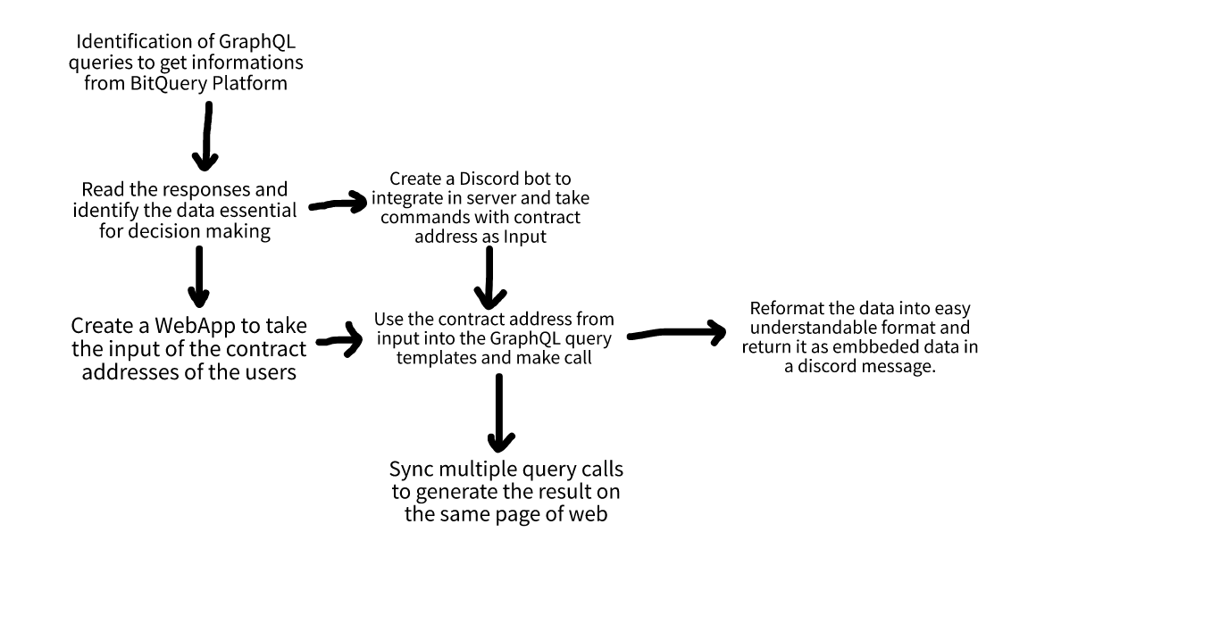
HOW we will progress in our project …

Slide 19
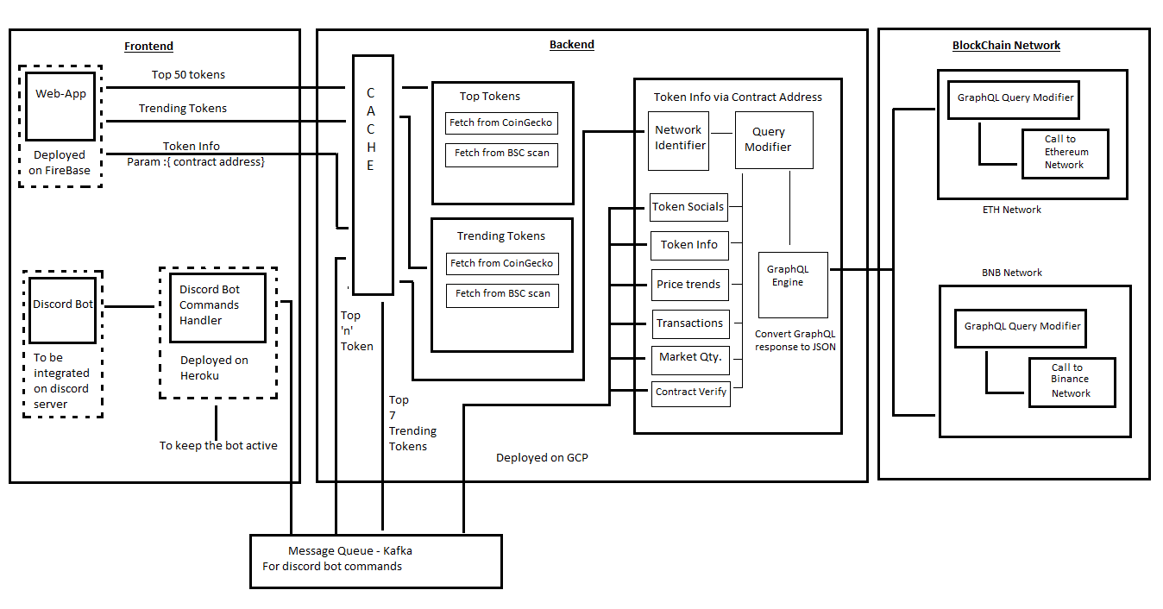
System Design Diagram

Slide 20
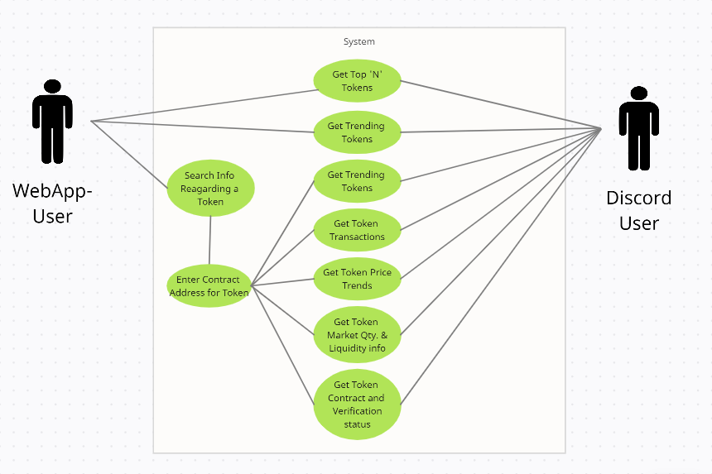
Use-Case Diagram…

Slide 21
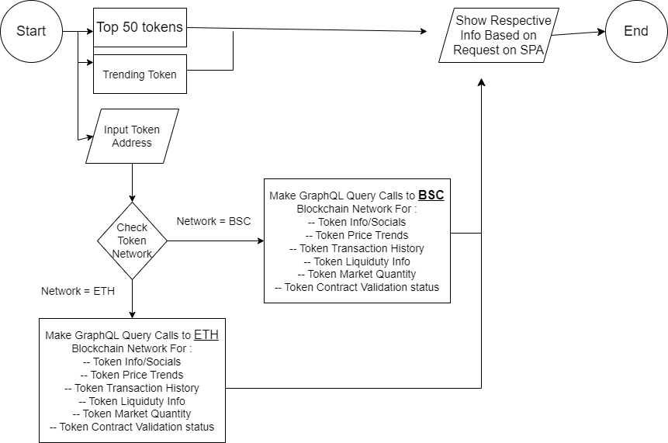
Web-App User Flowchart

Slide 22
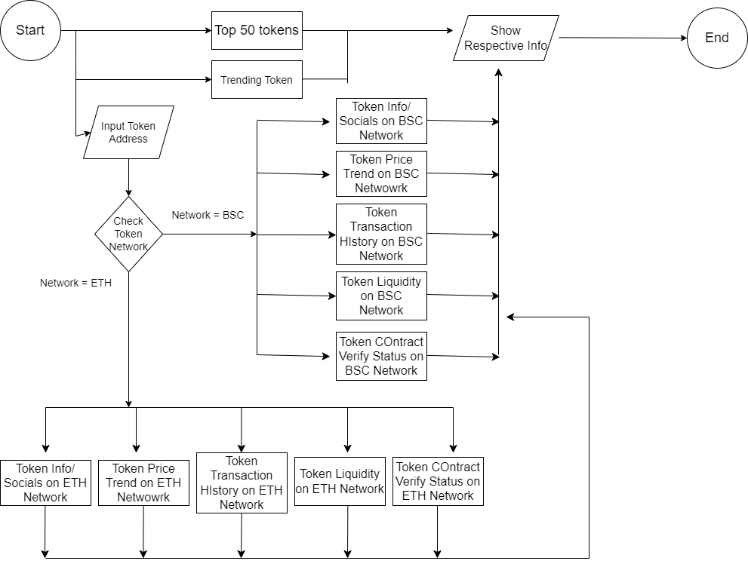
Discord-bot User Flowchart

Slide 23
Module Description
Frontend Module
Frontend Module consists of WebApp, which serves as a platform to provide all the data related to a particular token in one place.
And the discord bot, used by Crypto community members to get details about tokens just there without having to go to different websites.
Both of them interact with the same Backend API module. The frontend module passes on the token address and network of the crypto token and then shows the data received by the backend in an understandable format.
WebApp is built using Next.Js and Discord Bot runs on NodeJS.

Slide 24
Continued….
Backend Module
The backend Module combines Discord Bot running code and Query APIs bundled together.
It is deployed on Microsoft Azure WebJobs and built in JS.
The backend module keeps track of commands given to the discord bot and then invokes its respective APIs based on the user command.
The API is to be used commonly by WebApp and DiscordBot.
API sends queries by converting them to GraphQL format to interact with the Blockchain Networks like (Ethereum and Binance) to fetch the data related to the contract address.

Slide 25
03
PICTURE SECTION

Slide 26
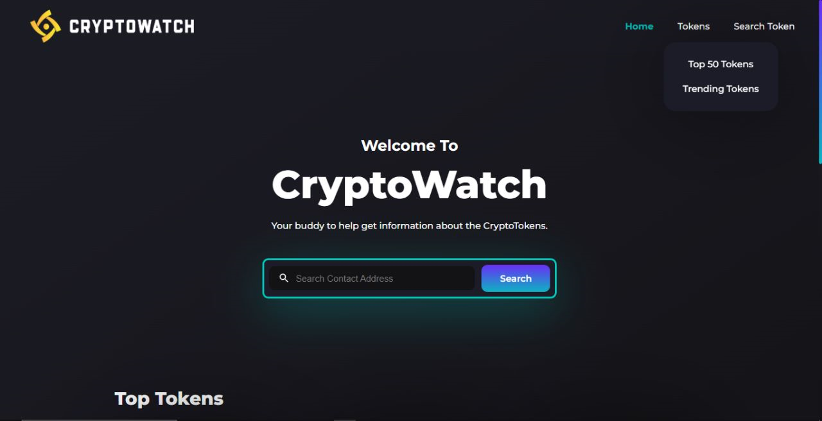
Website

Slide 27
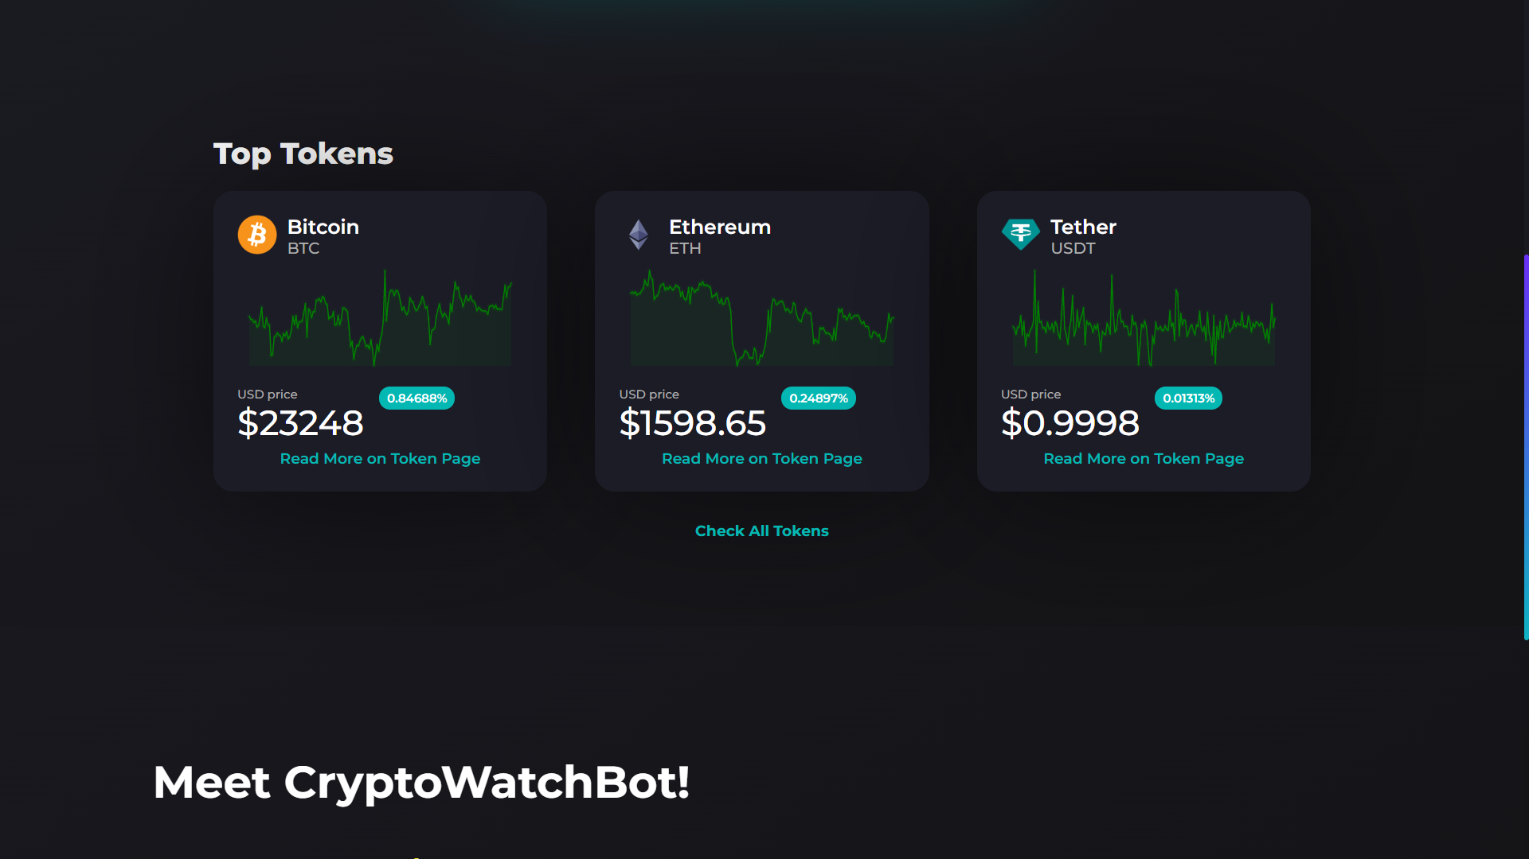

Slide 28
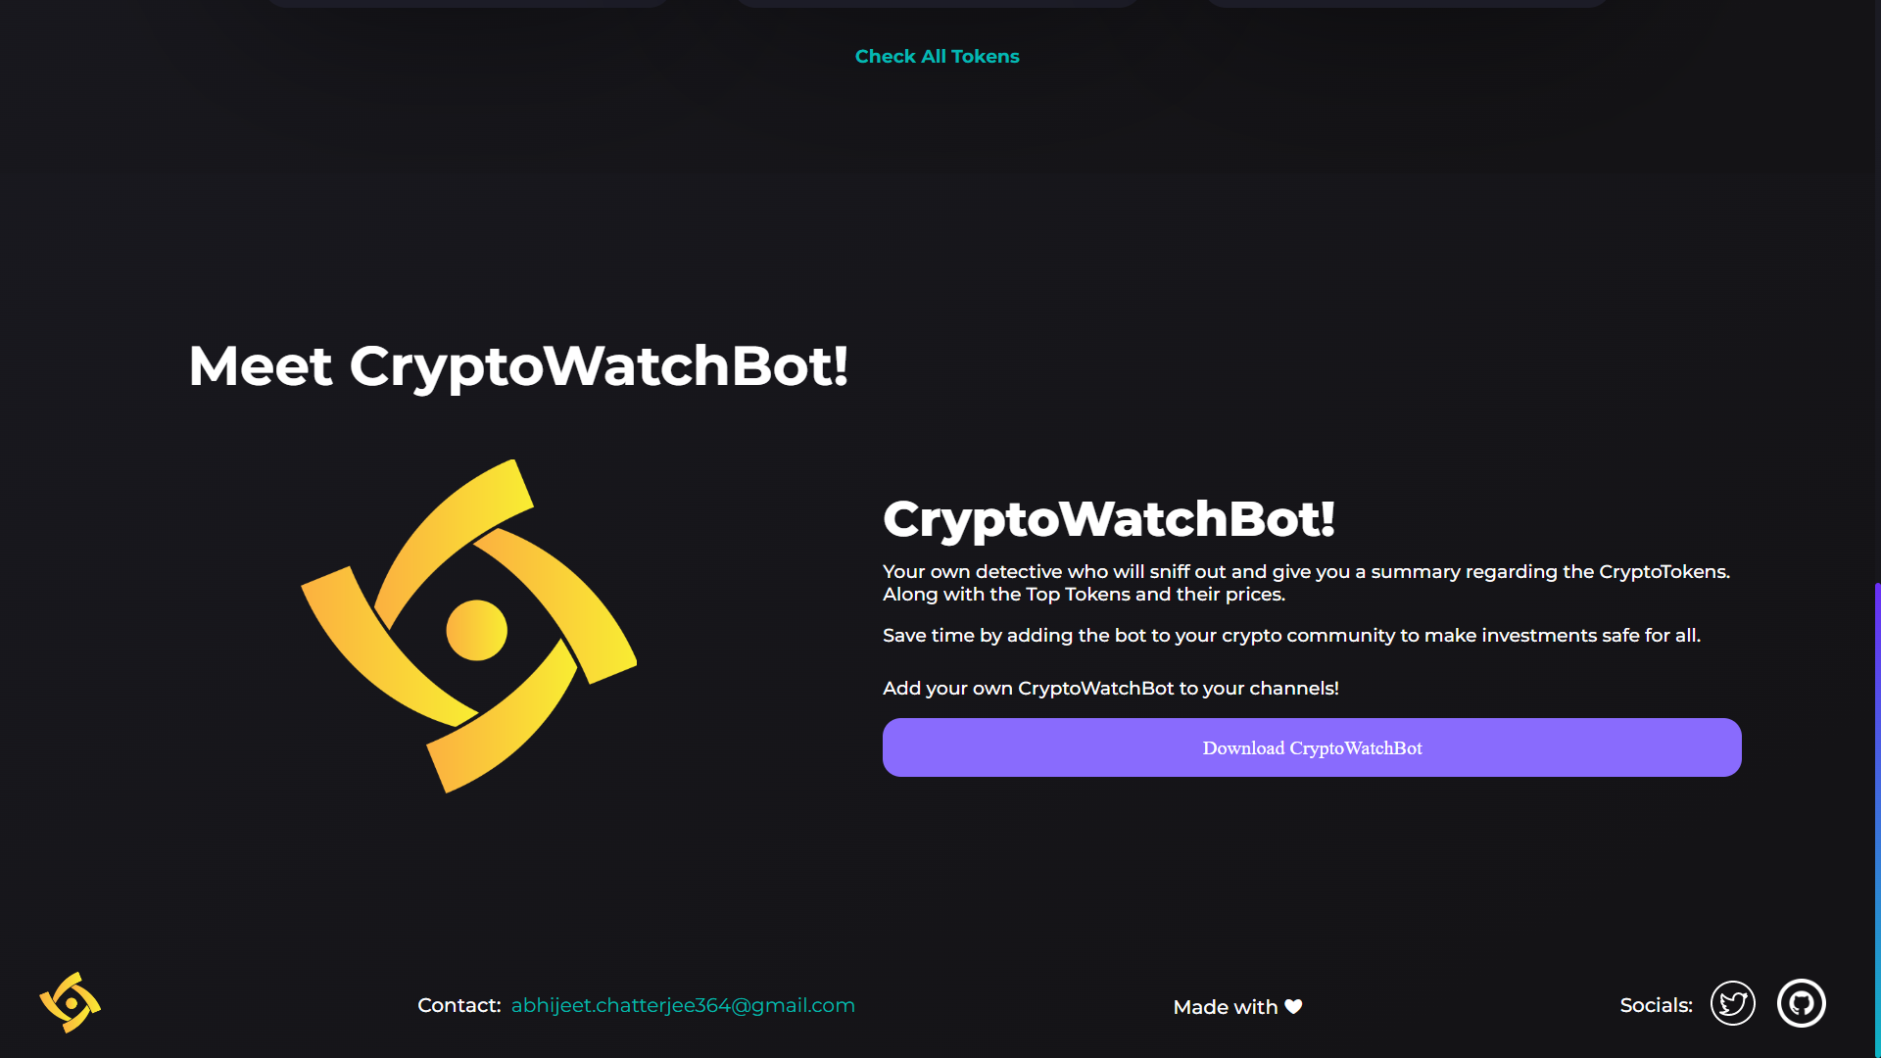

Slide 29
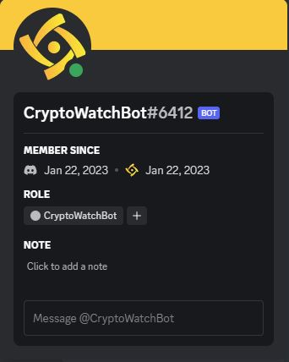
Discord Bot
Discord Bot

Slide 30
References
https://www.sciencedirect.com/science/article/abs/pii/S0275531919310037?via%3Dihub
M. Bartoletti, S. Lande, A. Loddo, L. Pompianu and S. Serusi, "Cryptocurrency Scams: Analysis and Perspectives," in IEEE Access, vol. 9, pp. 148353-148373, 2021, doi: 10.1109/ACCESS.2021.3123894.
W. Chen, T. Zhang, Z. Chen, Z. Zheng and Y. Lu, "Traveling the token world: A graph analysis of Ethereum ERC20 token ecosystem", Proc. Web Conf., pp. 1411-1421, Apr. 2020.
S. Kethineni and Y. Cao, "The rise in popularity of cryptocurrency and associated criminal activity", Int. Criminal Justice Rev., vol. 30, no. 3, pp. 325- 344, Sep. 2020
https://medium.com/@Watchtower_WTW/different-types-of-cryptocurrency-scams-1a9fbcb46267

Slide 31
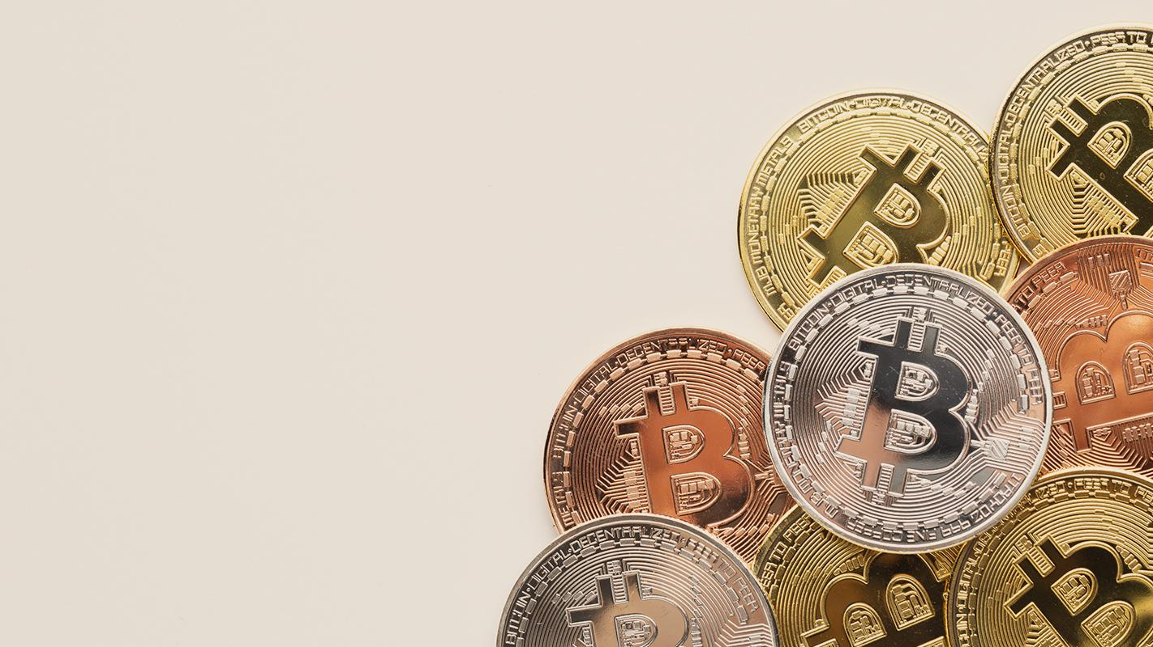
THANKS!

